Slide 1
Understanding Cryptocurrency Trading
Market Perspectives with TradingView Insights

Slide 2
Table of contents
01
02
03
04
05
06
Introduction to Cryptocurrency
Web Scraping
Showcasing Our Features
Data Cleaning
Key Insights & Findings
Conclusion

Slide 3
01
Introduction

Slide 4

What is a Cryptocurrency?
Definition: A digital or virtual currency secured by cryptography, making it nearly impossible to counterfeit or double-spend.
Key Features:
Decentralized: Operates on blockchain technology without central authority.
Borderless Transactions: Can be sent and received globally.
24/7 Trading: Unlike traditional markets, crypto is always active.
Volatility: Prices can fluctuate significantly.
Examples: Bitcoin (BTC), Ethereum (ETH), Binance Coin (BNB).

Slide 5
02
Web Scraping

Slide 6
TradingView: A Powerful Tool for Market Analysis
What is TradingView?
A charting platform for analyzing financial markets.
Supports cryptocurrencies, stocks, forex, and more.
Features for Crypto Traders:
Advanced Charts: Customizable indicators and drawing tools.
Real-Time Data: Live price movements and trends.
Community Insights: Shared strategies and ideas from traders.
Alerts & Automation: Set price alerts and use trading bots.
Why Use It?
Helps traders make informed decisions with technical analysis tools.
Accessible on web and mobile for on-the-go trading.

Slide 7
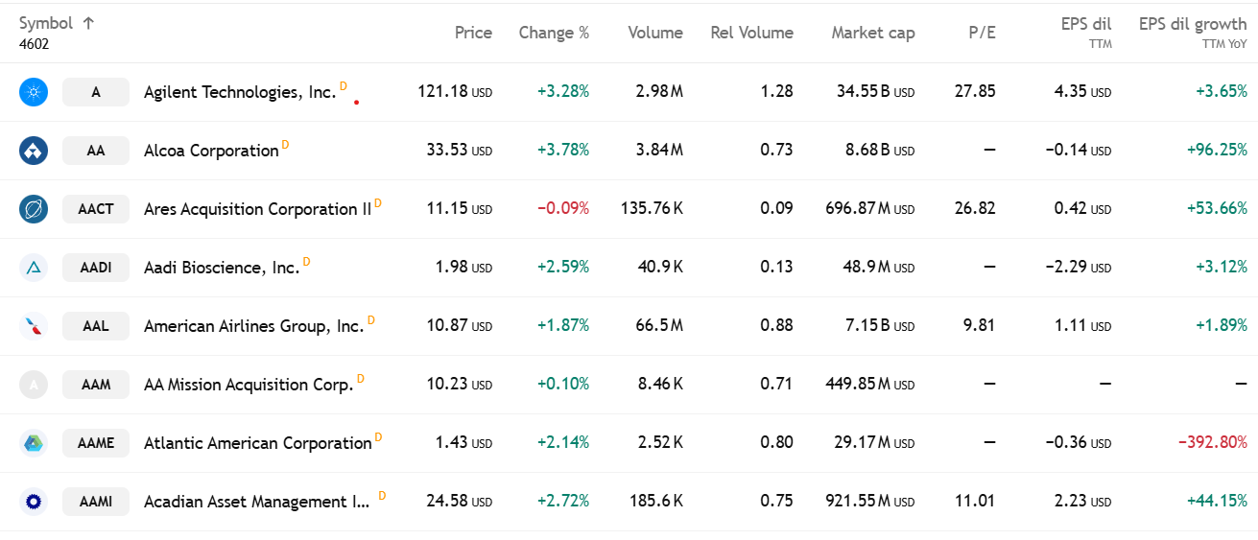
Web Scraping
The process begins by launching a Selenium WebDriver to access the TradingView cryptocurrency market page. Since the website dynamically updates content using JavaScript, we identified the cryptocurrency table and iterated through each row to capture relevant details. Given that TradingView continuously updates prices and other metrics, Selenium ensures elements are fully rendered before scraping. Once extracted, the data is structured using Pandas, allowing for easy processing and analysis., providing a structured format for further research,we can extract features from TradingView platform that we used This allows for data-driven decision-making.
We developed a cryptocurrency scraper that fetches real-time data and stores it in a structured CSV file for further analysis. By using exploration, visualization, and data handling techniques, we streamline the process of tracking and analyzing market trends efficiently.

Slide 8
3
Showcasing Our Features

Slide 9
Showcasing Our Features
Name
Rank
Price
24h Change
The name of the cryptocurrency.
The ranking of the cryptocurrency based on market cap.
The current price of the cryptocurrency.
The percentage change in price over the last 24 hours.
Market Cap
Volume
Circ_Supply
Category
The total market capitalization of the cryptocurrency.
The trading volume over the last 24 hours.
The circulating supply of the cryptocurrency.
The category or type of cryptocurrency

Slide 10
04
Data Cleaning

Slide 11
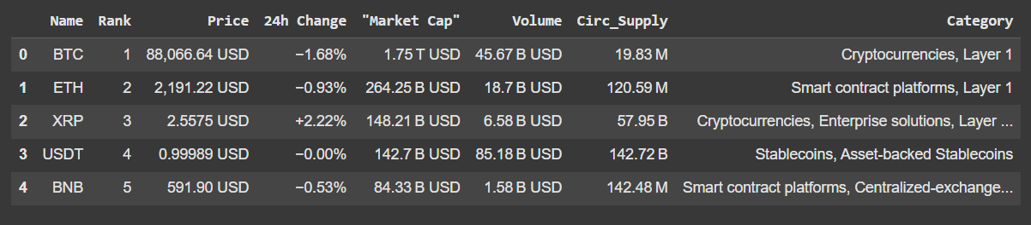
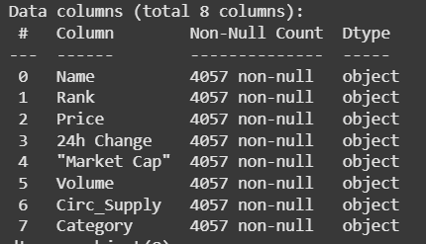
Data Cleaning
Let's take a look at
the dataset we scraped.
And Some info

Slide 12
Data Cleaning
Rank: Converted to a numerical format (integer).
24h Change: Replaced ‘-’ with the correct negative sign and converted it to a float.
Price, Market Cap, Volume, and Circ_Supply: Removed 'USD' and replaced shorthand notations (T, B, M) with their actual numerical values.
Category: Replaced '-' with 'Unknown' to standardize missing values.
Dropped 258 records due to excessive missing values, making them unusable.
Volume: Missing values were filled using the average of the preceding and following values for better accuracy.

Slide 13
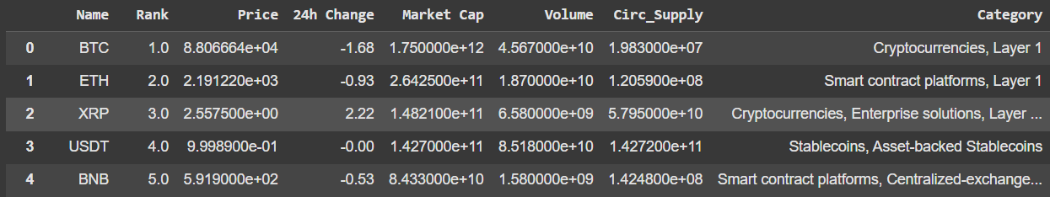
Data Cleaning
Dataset Post-Cleaning:

Slide 14
05
Key Insights & Findings

Slide 15
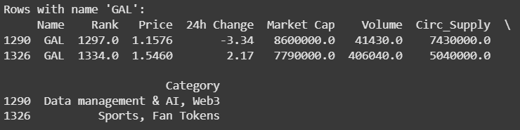
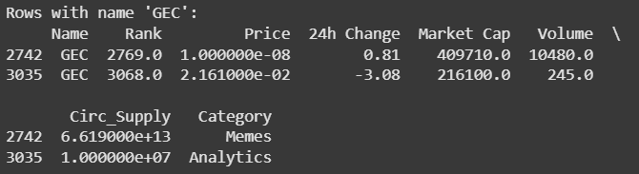
Key Findings:
Some cryptocurrencies appear multiple times in the dataset under different categories.
Their price, market cap, volume, circulating supply, and even ranking vary significantly, indicating possible discrepancies in classification or trading conditions across different platforms.

Slide 16
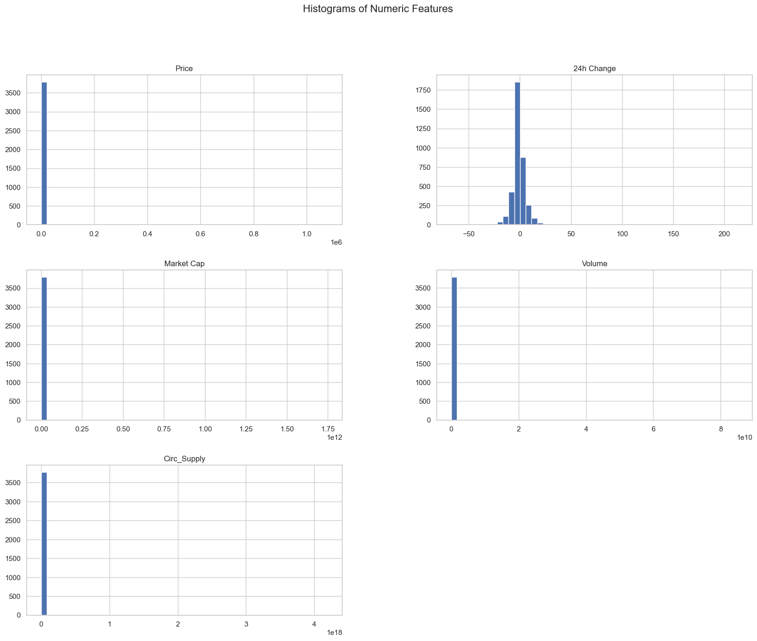
Key Findings:
EDA Motivation
We wanted to explore the histogram of the numeric features to know and get a glimpse of the distribution of them to be able to do with them if the distribution is skewed.
Insights
The 24-Hour change is the only feature that is almost normal-like but other features are heavily skewed indicating that we need to log transform them for example

Slide 17
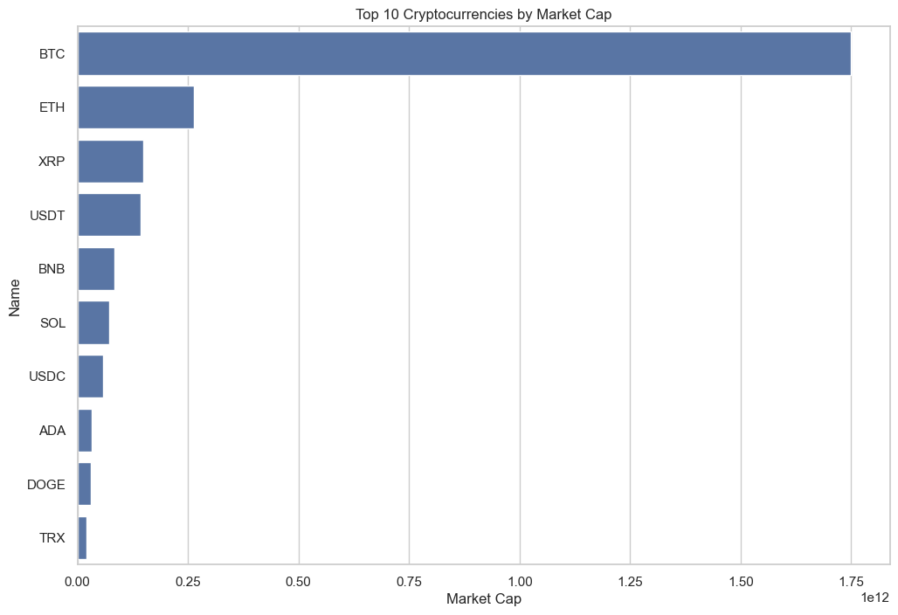
Key Findings:
EDA Motivation
We wanted to Visualize and explore the top 10 cryptocurrencies based on their market capitalization.
Insights
BTC and ETH lead in market cap, followed by stablecoins like USDT and XRP.
This highlights the dominance of Layer 1 blockchains and stablecoins in the crypto market.

Slide 18
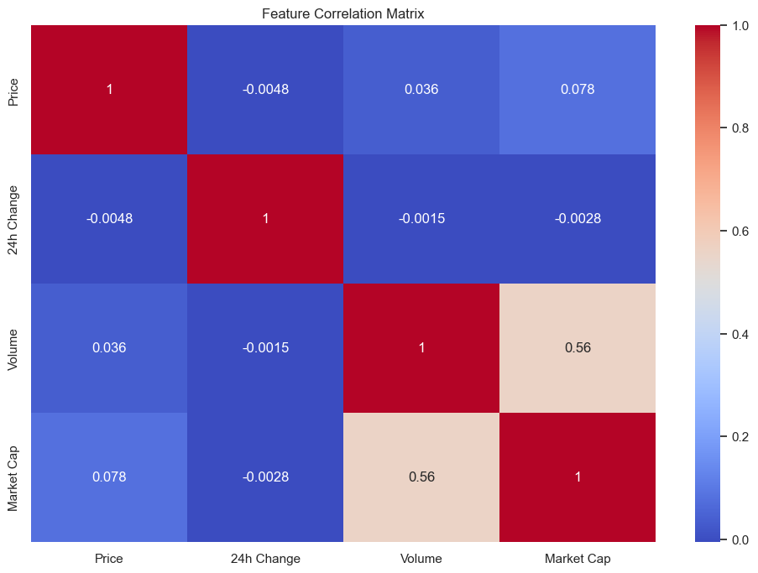
Key Findings:
EDA Motivation
We wanted to explore the correlation matrix of the numeric features to understand if there is a +ve or -ve correlation or causality between features.
Insights
Market cap and volume have a strong positive correlation (0.56)
However, price, rank, and circulating supply show weak or no correlation with other features

Slide 19
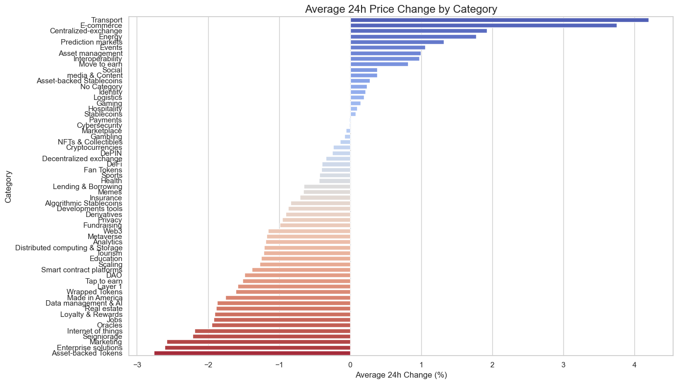
Key Findings:
EDA Motivation
We wanted to Analyze the average daily price change for each category.
Insights
Transport and E-commerce show the highest volatility with large price swings.
Stablecoins, Payments, and Cybersecurity are the least volatile, reflecting stability and real-world utility.

Slide 20
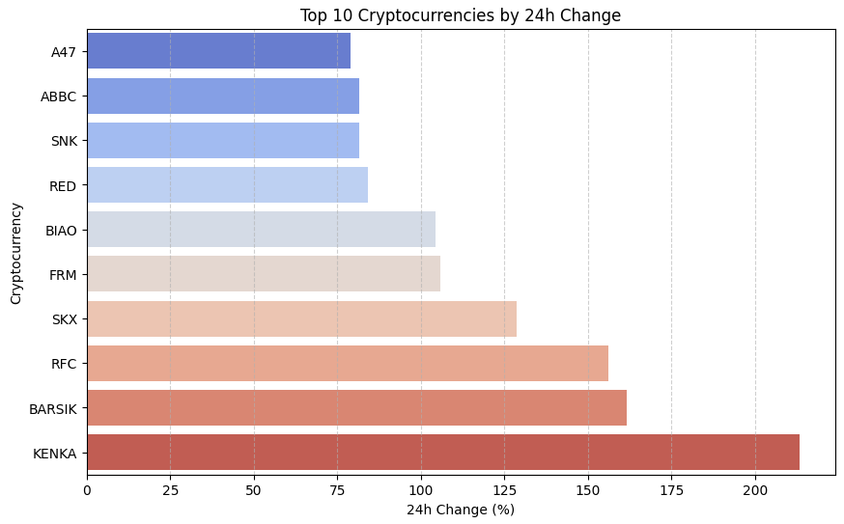
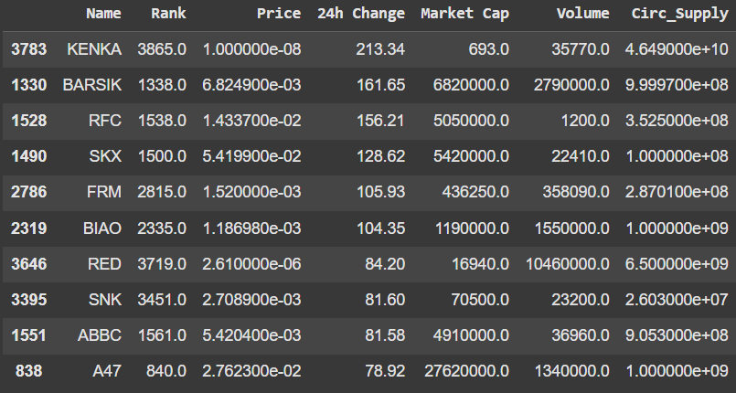
Key Findings:
Top 10 cryptocurrencies by 24h Change:

Slide 21
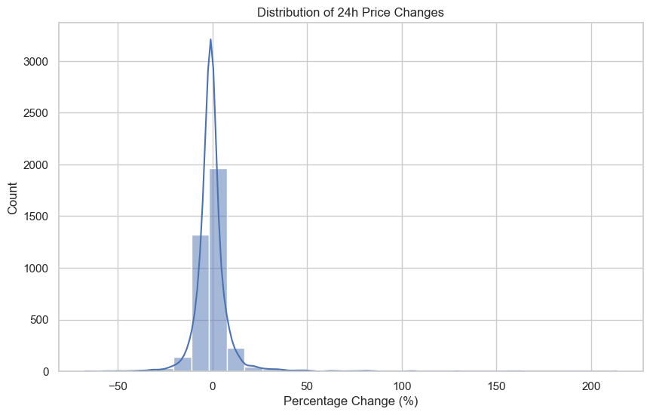
Key Findings:
EDA Motivation
We wanted to analyze the distribution of daily price changes across all cryptocurrencies.
Insights
Most cryptocurrencies see minor daily price changes (-10% to +10%).
Some outliers, like meme coins, exhibit extreme volatility.

Slide 22
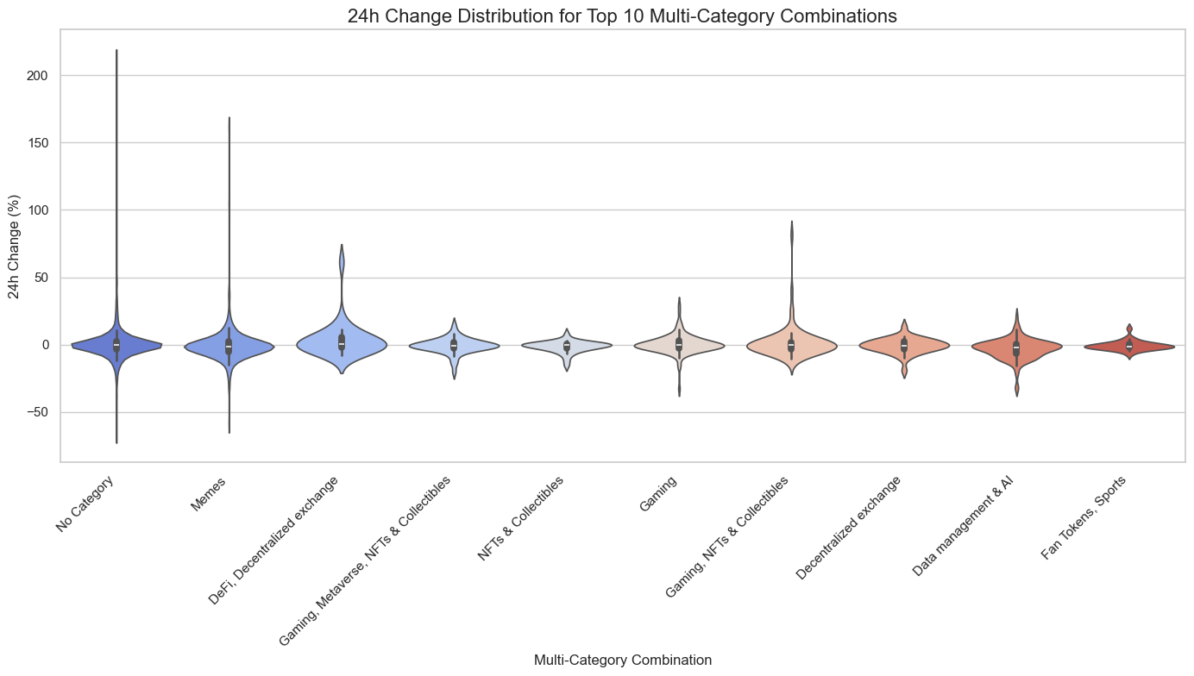
Key Findings:
EDA Motivation
We wanted to Examine the distribution of daily price changes for the top 10 multi-category combinations.
Insights
No Category & Memes show extreme volatility with large gains and losses.
NFTs & Fan Tokens remain stable with minimal price changes.

Slide 23
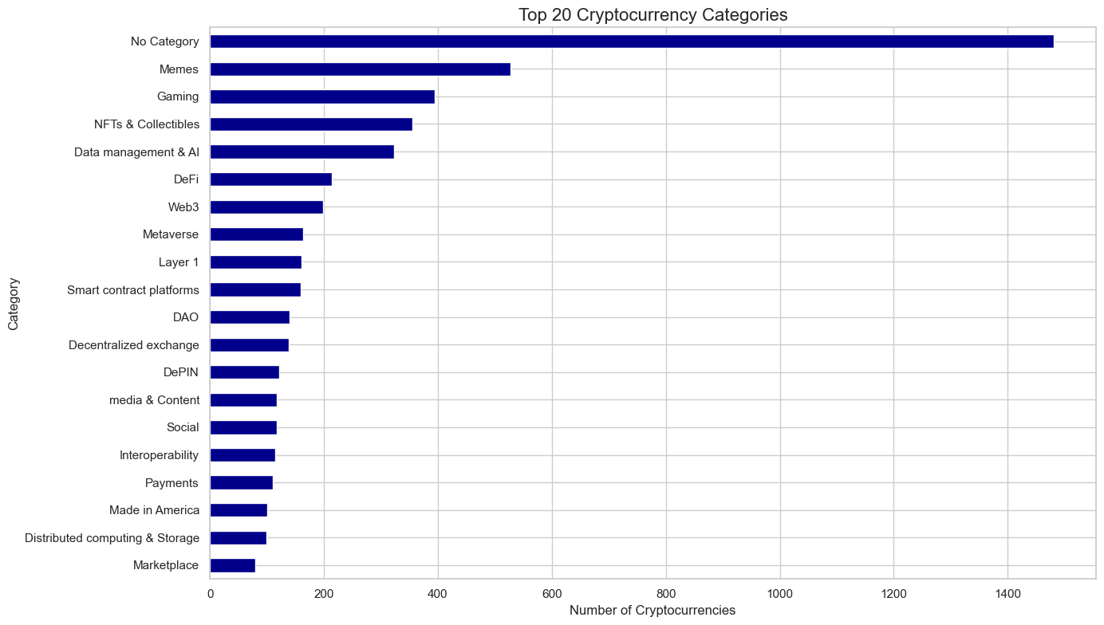
Key Findings:
EDA Motivation
We wanted to Explore the distribution of cryptocurrencies across different categories to know which category appears the most.
Insights
"No Category currencies" lead in number, showing many assets lack classification.
Memes and Gaming rank high, driven by strong communities and entertainment focus.
NFTs, AI, and DeFi see strong growth, reflecting rising interest in digital assets and decentralization.
Smart Contract Platforms and Layer 1 have moderate presence, indicating competition in blockchain infrastructure.
Marketplace, Computing, and Payments have fewer assets, suggesting niche or mature markets.

Slide 24
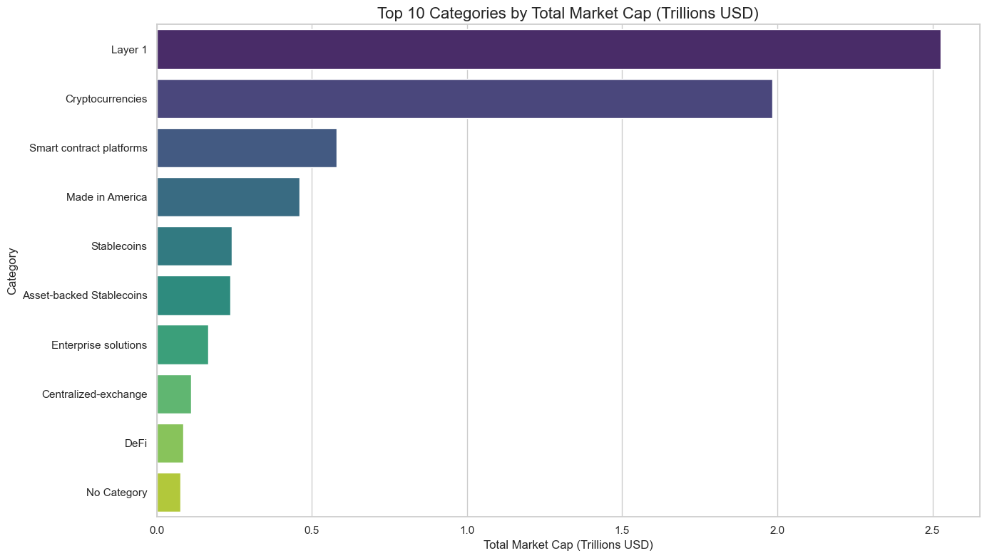
Key Findings:
EDA Motivation
We wanted to Analyze the total market capitalization for each category to know which ones are the highest total market cap.
Insights
Layer 1 and Cryptocurrencies lead in market cap, driven by BTC and ETH.

Slide 25
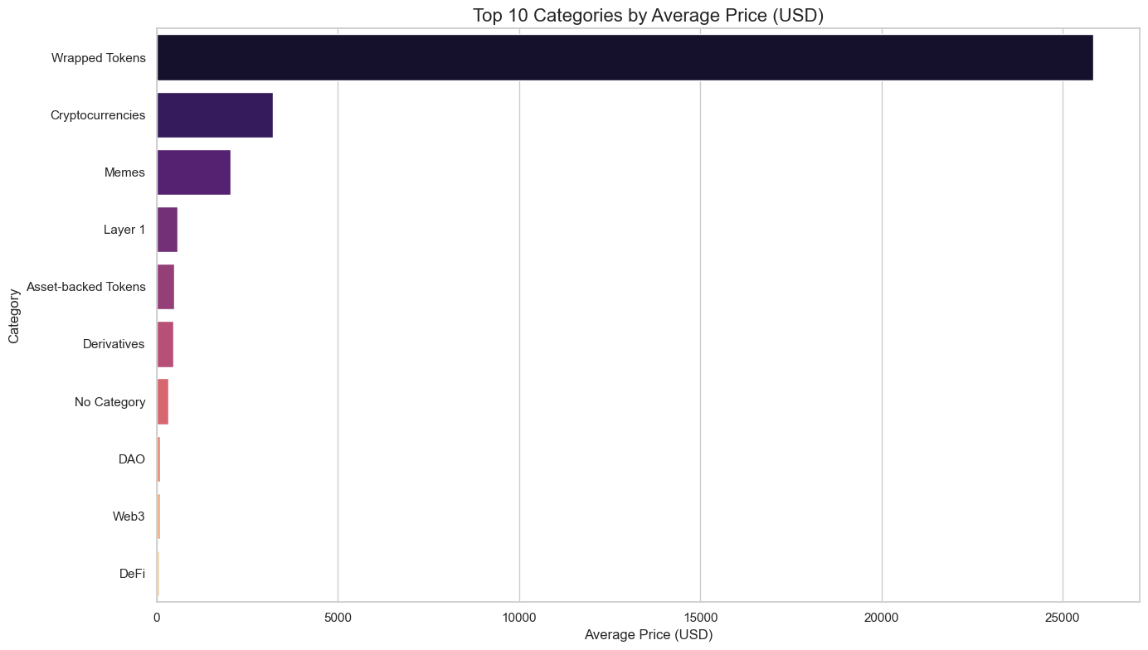
Key Findings:
EDA Motivation
We wanted to Examine the average price of cryptocurrencies in each category.
Insights
Wrapped Tokens and Cryptocurrencies have the highest average prices, reflecting their significance and high-value use cases.

Slide 26
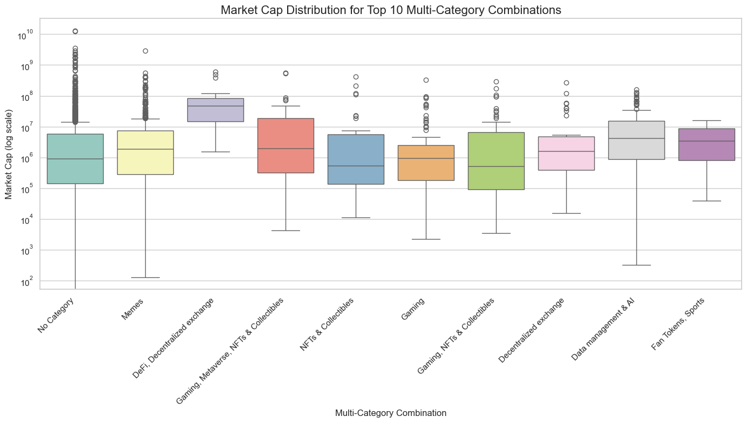
Key Findings:
EDA Motivation
We wanted to visualize the distribution of market caps for the top 10 multi-category combinations.
Insights
DeFi & Decentralized Exchanges have the highest median market cap.
Gaming & NFTs show high potential but significant volatility.
No Category & Memes have lower medians but a broad range.
AI, Data Management, and Fan Tokens maintain stable market caps, reflecting steady investor interest.

Slide 27
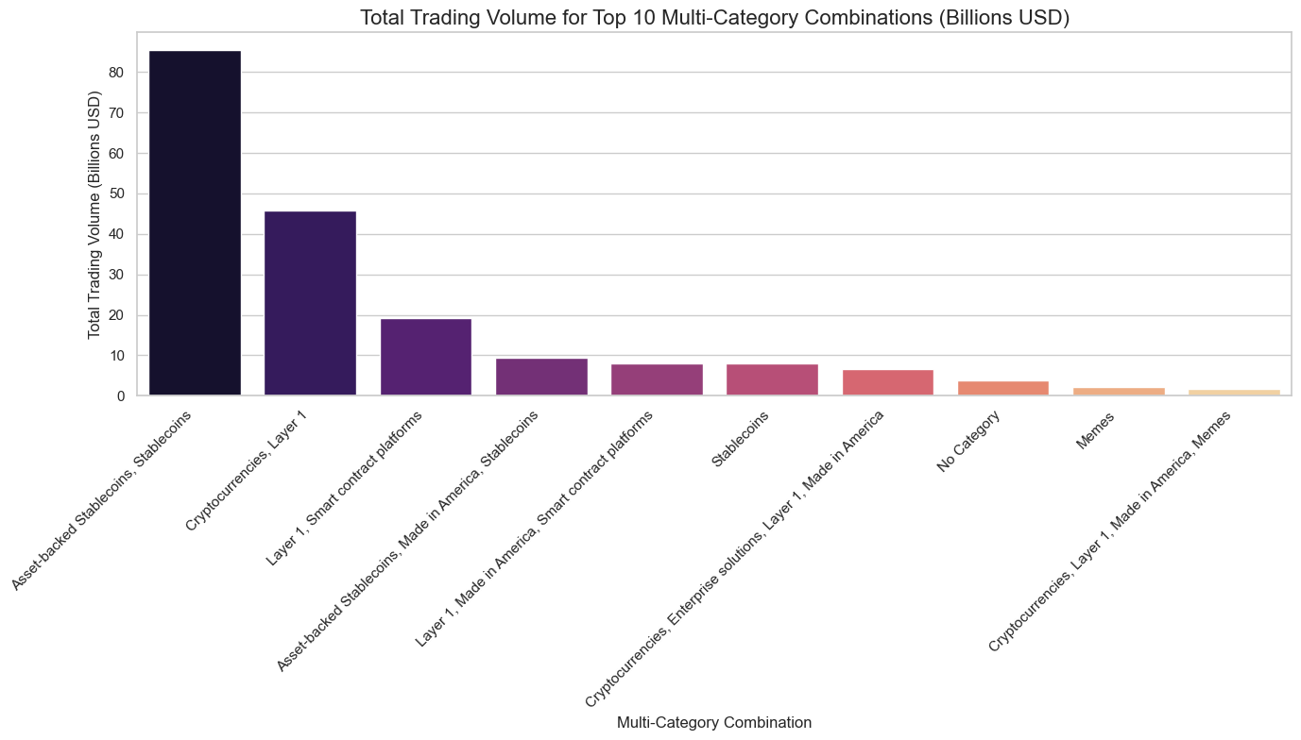
Key Findings:
EDA Motivation
We wanted to analyze the total trading volume for the top 10 multi-category combinations to see what’s the highest among them.
Insights
Layer 1 & Asset-Backed Stablecoins lead in trading volume, highlighting their market significance.

Slide 28
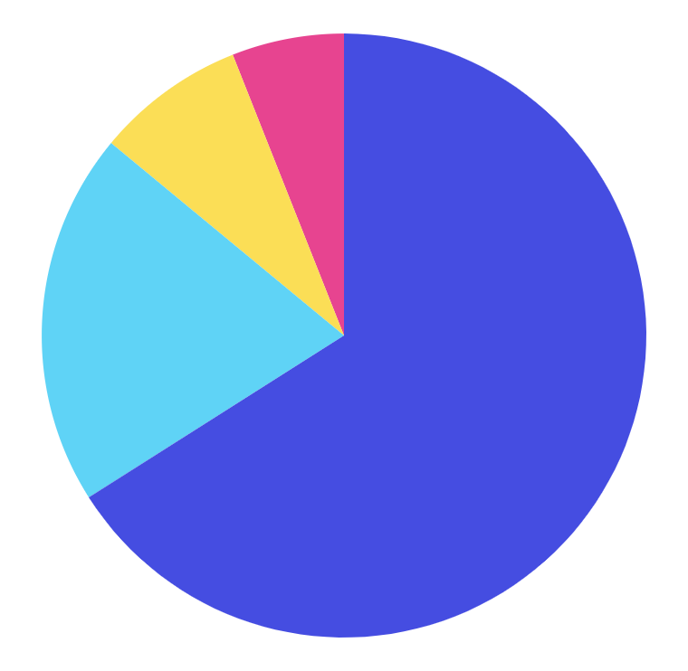
Top 4 Cryptocurrency Categories
66%
Gaming
20%
NFT’s & Collectibles
8%
Data Management & AI
6%
Memes

Slide 29
Thanks!
Do you have any questions?

